Slide 1
Standard Deviation as a Distance Measure

Slide 2
Comparing Different-Looking Values
You have a job offer of Rs.8.2 lakh in Hyderabad and another of Rs8.6 lakh in Bangalore. The mean and variance for similar jobs in Hyderabad were Rs.7 lakh and Rs.9 lakh, while for Bangalore, these were Rs.7.4 lakh and Rs.12.25 lakh. Which is a better job offer?
The Feb “high” temperature averaged 30ºC with variance 100ºC, while in May these were 40ºC and 64ºC. When is it more unusual to have a high of 35ºC?

Slide 3
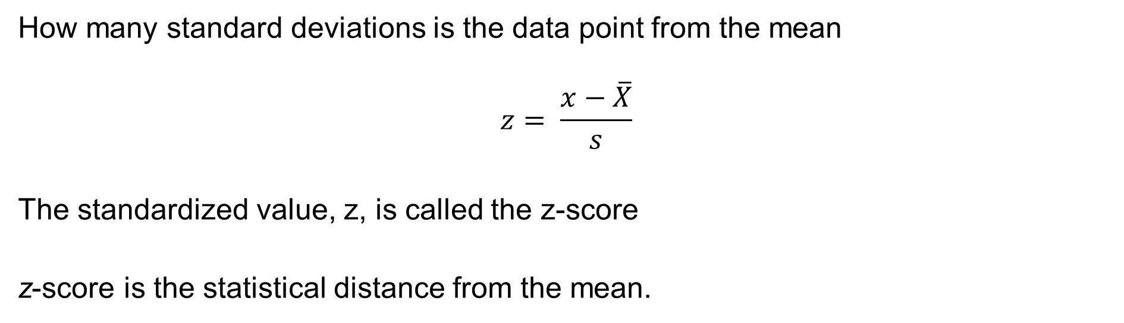
The Standard Deviation as a Distance Measure
How many standard deviations is the data point from the mean
$$z= \frac{x−\overline{X}}{s}$$
The standardized value, z, is called the z-score
z-score is the statistical distance from the mean.

Slide 4
The Standard Deviation as a Ruler – Example 1
You have a job offer of Rs.8.2 lakh in Hyderabad and another of Rs8.6 lakh in Bangalore. The mean and variance for similar jobs in Hyderabad were Rs.7 lakh and Rs.9 lakh, while for Bangalore, these were Rs.7.4 lakh and Rs.12.25 lakh. Which is a better job offer?
Z-Scores:
Z_{hyd} = (8.2-7)/3 = 0.4 &
Z_{bgl} =(8.6-7.4)/3.5 = 0.3429
Hyderabad: The offer is 0.4 σ’s from the mean
Bangalore: The offer is 0.34 σ’s from the mean

Slide 5
The Standard Deviation as a Ruler – Example 2
The Feb “high” temperature averaged 30ºC with variance 100ºC, while in May these were 40ºC and 64ºC. When is it more unusual to have a high of 35ºC?
Z Scores
Z_{feb} = (35-30)/10 = 0.5 &
Z_{jun} = (35-40)/8 = -5/8 = -0.625
February: 35ºC is 0.5 σ’s from the mean
May: 35ºC is 0.625 σ’s from the mean (Ignoring the negative sign)

Slide 6
Z Score & Outliers
How does this help us?
If we assume that anything beyond ±kσ is an outlier, then we have another tool to analyse data

Slide 7
Z Score & Outliers Example
Your team member says he has received a job offer of Rs.15 lakh in Hyderabad and would like to put in his papers.
He is a good resource but he is a little pushy.
Should you negotiate with him and try and increase his salary or tell him you cannot match that offer and he should put in his papers.
HR says that for his level in Hyd, m = Rs.8 lakh and s = Rs.2 lakh.
z score of the offer = (15 – 8) / 2 = 3.5
Is the employee bluffing?

Slide 8
Chebyshev’s Theorem
At least (1 - 1/z²) of the items in any data set will be within z standard deviations of the mean, where z is any value greater than 1.
Chebyshev’s theorem requires z > 1, but z need not be an integer.
At least 75% of the data values must be within 2 standard deviations from the mean

Slide 9
Chebyshev’s Theorem
At least (1 - 1/z²) of the items in any data set will be within z standard deviations of the mean, where z is any value greater than 1.
Chebyshev’s theorem requires z > 1, but z need not be an integer.
At least 75% of the data values must be within 2 standard deviations from the mean
At least 89% of the data values must be within 3 standard deviations from the mean

Slide 10
Chebyshev’s Theorem
At least (1 - 1/z²) of the items in any data set will be within z standard deviations of the mean, where z is any value greater than 1.
Chebyshev’s theorem requires z > 1, but z need not be an integer.
At least 75% of the data values must be within 2 standard deviations from the mean
At least 89% of the data values must be within 3 standard deviations from the mean
At least 94% of the data values must be within 4 standard deviations from the mean

Slide 11
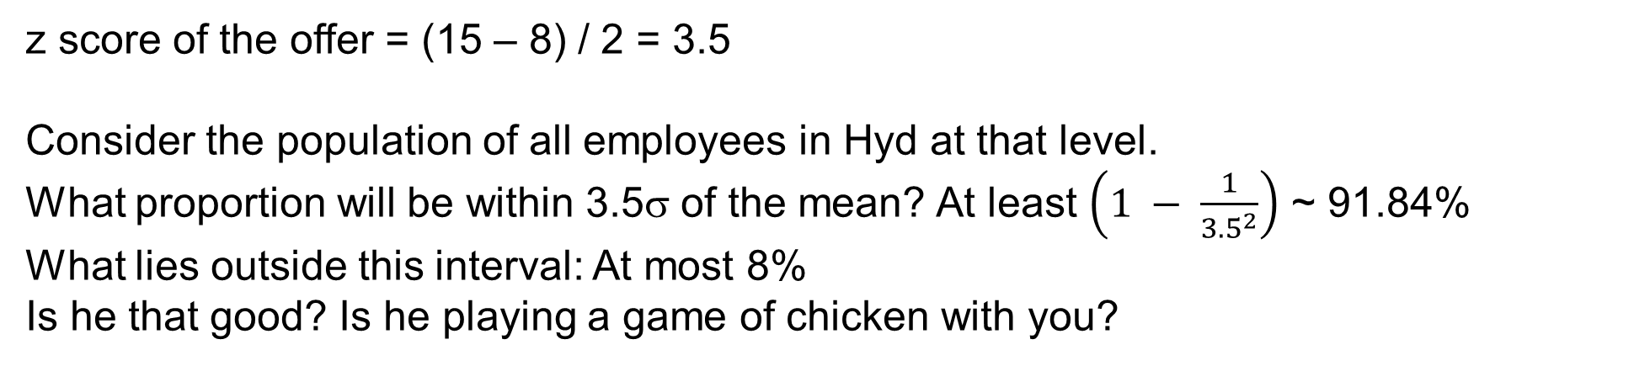
Chebyshev’s Theorem & Outliers
At least (1 - 1/z²) of the items in any data set will be within z standard deviations of the mean, where z is any value greater than 1.
How does this help us?
Recall the team member with a a job offer of Rs.15 lakh in Hyderabad.
Should you try and retain him or start the separation process?
Recall also for his level in Hyd, μ = Rs.8 lakh and σ = Rs.2 lakh.
z score of the offer = (15 – 8) / 2 = 3.5
Consider the population of all employees in Hyd at that level.
What proportion will be within 3.5σ of the mean? At least $\left(1 − \frac{1}{{3.5}^{2}}\right)$ ~ 91.84%
What lies outside this interval: At most 8%
Is he that good? Is he playing a game of chicken with you?

Slide 12
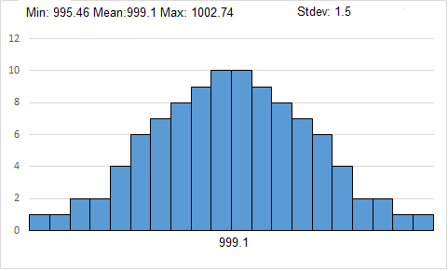
A Symmetric Histogram & Chebyshev’s Theorem
Notice: The interval (μ - 3σ, μ + 3σ ) = (994.6, 1003.6) contains 100% of the data
Recall Chebyshev’s theorem guaranteed at least 89%.
The difference is that the current data set is symmetric.

Slide 13
Empirical Rule & Outliers
99.72%
95.44%
68.26%
x
μ
μ – 3σ
μ – 1σ
μ + 1σ
μ + 3σ
μ – 2σ
μ + 2σ

Slide 14
Empirical Rule & Outliers
99.72%
95.44%
Recall the team member with a a job offer of Rs.15 lakh in Hyderabad.
Should you try and retain him or start the separation process?
Recall also for his level in Hyd, μ = Rs.8 lakh and σ = Rs.2 lakh.
z score is 3.5
Suppose the salaries for his profile and level are bell shaped
68.26%
x
μ
μ – 3σ
μ – 1σ
μ + 1σ
μ + 3σ
μ – 2σ
μ + 2σ

Slide 15
Takeaways
Standard Deviation as a Distance Measure
Z Score
Chebyshev’s Theorem
Chebyshev’s Theorem & Outliers
Empirical Rule & Outliers

